Slide 1

MBOKODO
Consulting
Services
Integrated advisory. Practical solutions.
Service with a difference.
COMPANY PROFILE
MBOKODO | SERVICE WITH A DIFFERENCE
01
Notes:
[Sources]
- Visual on this slide was generated with Microsoft Copilot.
[/Sources]

Slide 2
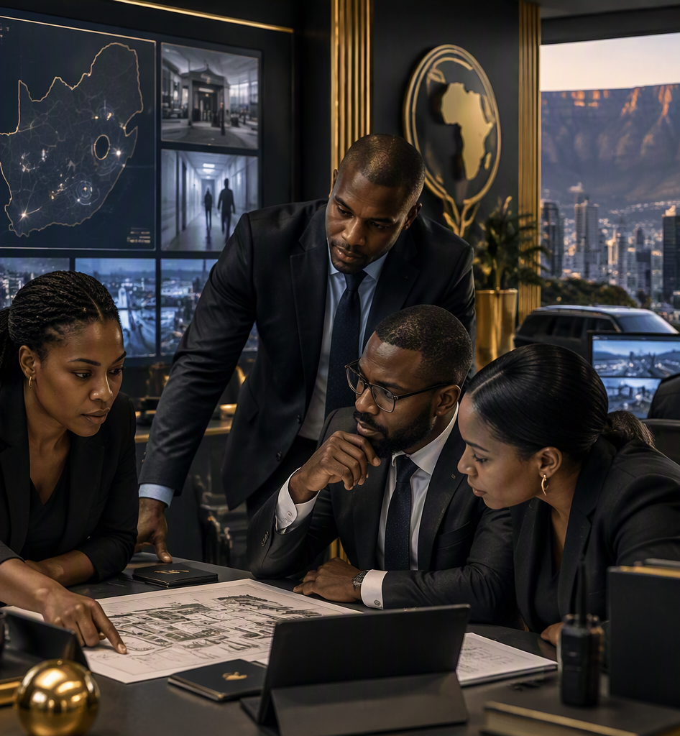
ABOUT
A multi-disciplinary partner for complex business needs
We combine specialist capability with responsive, client-centred delivery.
Mbokodo Consulting Services brings together experienced professionals to help organisations solve operational, people, security, investigative and mobility challenges. Our approach is practical and tailored to each client environment, with a focus on quality, discretion and a strong service experience.
CLIENT-CENTRED
PRACTICAL
RESPONSIVE
Purpose
Enable better business outcomes through intelligent, fit-for-purpose advisory and support.
MBOKODO | SERVICE WITH A DIFFERENCE
02
Notes:
[Sources]
- Visual on this slide was generated with Microsoft Copilot.
[/Sources]

Slide 3
CAPABILITIES
One partner. Six connected service pillars.
A focused portfolio designed around the realities of corporate operations.
01
02
03
People & HR
Forensics & Investigations
Wellness & Social Impact
HR advisory, recruitment, benefits, screening, policy support and bursary administration.
Investigations, asset tracing, policy advice and labour or criminal-justice support.
Employee wellness, CSR programme design, project delivery and tailored corporate training.
04
05
06
Security & Risk
Business & Facilities
Executive Travel & Concierge
Security reviews, travel risk support, crisis readiness, investigations and event protection support.
Process improvement, policy reviews, quality support, tracing, collections and property maintenance.
End-to-end mobility, events and high-touch travel support for corporate and private clients.
MBOKODO | SERVICE WITH A DIFFERENCE
03

Slide 4

SECURITY & RISK
Protecting people,
places and journeys
Practical security advisory and support built around client risk, operating context and duty-of-care requirements.
Office & residential security surveys
Travel security and destination support
Crisis & emergency management advisory
Investigations and event security support
Protection services and tailored security awareness
MBOKODO | SERVICE WITH A DIFFERENCE
04
Notes:
[Sources]
- Visual on this slide was generated with Microsoft Copilot.
[/Sources]

Slide 5
PEOPLE & INTEGRITY
Stronger organisations start with people and trust
Specialist support across the employee lifecycle, investigations and organisational wellbeing.
01
02
03
Human Resources
Forensic Services
Wellness & Social Impact
• HR advisory and workforce support
• Recruitment and hiring
• Compensation and benefits support
• Background screening
• Policy and procedure development
• Bursary administration
• Forensic investigations
• Asset tracing and tracking
• Policy advisory
• CCMA support and advisory
• Criminal-justice advisory and support
• Employee wellness support
• CSR programme design
• Project management and delivery support
• Tailored corporate training programmes
MBOKODO | SERVICE WITH A DIFFERENCE
05

Slide 6
OPERATIONS
Practical support that keeps business moving
From process improvement to facilities support, we help clients protect continuity and service quality.
Business Advisory
Facilities & Property Support
Operational support
Business process review & optimisation
Service quality improvement
Corporate policy reviews
Tracing services for debtors / beneficiaries
Debt collection support
Plumbing
Electrical support
Painting
General office maintenance
Small to medium office projects
MBOKODO | SERVICE WITH A DIFFERENCE
06

Slide 7
EXECUTIVE TRAVEL & CONCIERGE
From planning to arrival,
we manage the details.
A high-touch service for executives, teams and private clients who need reliable coordination before, during and after travel.
TRAVEL READINESS
EXECUTIVE MOBILITY
EVENTS & ROADSHOWS
ALWAYS-ON SUPPORT
Visa and passport support
Travel insurance & emergency evacuation
Destination and itinerary advisory
Airport meet & greet
Executive airport services
Chartered flight coordination
Conferences and strategic sessions
Domestic & international roadshows
High-touch experience management
Hotel, transport & excursion support
After-hours emergency assistance
Holiday and personal event planning
MBOKODO | SERVICE WITH A DIFFERENCE
07

Slide 8
WHY MBOKODO
Experience with a service mindset
A compact, senior-led model built to deliver relevant solutions with care and accountability.
01
Cross-sector perspective
Experience across diverse operating environments helps us understand both customer and provider realities.
130+
years of combined experience
02
Tailored, not templated
Solutions are shaped around the client context, priorities and risk profile.
across corporate, government, diplomatic, private, public, development and NGO environments.
03
Integrated capability
People, risk, operations and mobility support can be coordinated through one partner.
04
High-touch delivery
Responsive engagement, practical execution and attention to the client experience.
MBOKODO | SERVICE WITH A DIFFERENCE
08

Slide 9
LET’S TALK
Solutions shaped
around your world.
Mbokodo Consulting Services
619 20th Ave, Rietfontein
Pretoria, Gauteng
+27 82 960 9693
masinthle@gmail.com
Company registration: 2022/668634/07
VAT registration: 9534385209
MBOKODO | SERVICE WITH A DIFFERENCE
09
Notes:
[Sources]
- Visual on this slide was generated with Microsoft Copilot.
[/Sources]

